Slide 1
SEED GERMINATION
Under normal conditions the mature embryo does not continue to grow while the seed is still attached to the parent plant. After dispersal of the seed, if environmental conditions are favorable there is resumption of the growth of embryo inside a viable non-dormant seed. This is the process known as germination.

Slide 2
A MATURE SEED
Viable (living embryo)
Non viable (dead embryo)
The mature embryo before the seed is shed from the parent plant enters a resting stage during which its metabolic rate is very low.
Dormant
Non dormant

Slide 3
The Process of seed germination
Seed absorbs water by imbibition (a physical process in which living or dead plant materials takes up water or liquid mainly by adsorption) and seed coat softens and burst. It is the first sign of germination.
The imbibed water hydrates the cytoplasm which leads to activation of enzymes in the embryonic axis that mobilize the reserve food material for growth.
Chemical energy stored in the form of starch is converted to sugar, which is used during germination.
There is an increase in the respiration rate that generates energy (ATP) for cell enlargement and cell division. This results in increase in size of the embryo which pushes against the seed coat and it bursts open.
The growing radicle is the first to emerge out of the seed and helps to anchor the seed in the soil. It also allows the embryo to absorb minerals and water from soil.
The germination process ends as soon as the radicle emerges from the seed coat.

Slide 4
Mobilization of reserve food material for development of seedling in monocot
On hydration of the seed, the cells of the embryonic axis produce gibberellic acid
After 24 hours the scutellum also produces gibberellic acid.
The gibberellic acid is transported to the aleurone layer where it induces the synthesis of an enzyme, α-amylase. The enzymes namely protease, ribonuclease, β-1,3-glucanase and lipases are already present in the aleurone layer. These enzymes are hydrated and activated. After hydration all 5 enzymes (α-amylase, protease, ribonuclease, β-1,3-glucanase and lipase) in the aleurone layer are released into the endosperm.
These enzymes break down the stored food material in the endosperm cells –
α-amylase breaks down starch to sugar
proteases break down proteins to amino acids
ribonuclease breaks down RNA to nucleic acid
β-1,3-glucanase breaks down hemicelluloses (a component of the cell wall of endosperm cells) to sugars
lipases breaks down oils into glycerol and fatty acids

Slide 5
The broken down food material are transported from the endosperm through the scutellum into the growing regions (root and shoot apices) of the embryonic axis.
Prior to the transport of nutrients from the endosperm, the embryo produces IAA (Indole Acetic Acid) that is transported to the scutellum for the development of vascular tissue in the scutellum.
The developed vascular tissue are the conduit/channel for the nutrient (sugars, amino acids, nucleic acids)flow to the embryonic axis.
The growing regions of the embryonic axis use the nutrients for the cell division and expansion of the divided cells which will result in increase in size of the embryonic axis – seedling growth.

Slide 6
Mobilization of reserve food material for development of seedling in dicots
Enzymes namely proteases, ribonuclease, β-1,3-glucanase and lipases are already present in the cotyledons.
α-amylase is freshly synthesised prior to mobilization of food reserve in the cotyledon.
These enzymes break down the stored food material in the cotyledon or endosperm cells
α-amylase breaks down starch to sugar
proteases break down proteins to amino acids
ribonuclease breaks down RNA to nucleic acid
β-1,3-glucanase breaks down hemicelluloses (a component of the cell wall of endosperm cells) to sugars
lipases breaks down oils into glycerol and fatty acids
In addition, cytokinins (another group of plant hormones) are also thought to be involved in controlling breakdown of reserves in the seeds.
The breakdown reserves are transported to the embryonic axis for cell division and enlargement of the divided cells leading to increase in size of the embryonic axis – seedling growth.

Slide 7
Modes of Germination or Seedling Emergence
The way in which the shoot emerges from the seed during germination varies from species to species.
The shoot can either be accompanied by the cotyledons or endosperm or it can emerge alone leaving the cotyledon or endosperm underground.
Thus there are 2 modes of germinations: Epigeal and Hypogeal

Slide 8
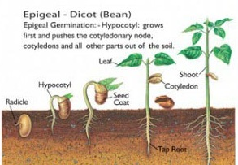
Epigeal germination
In epigeal germination, both the plumule and cotyledons are thrust out of the ground by the elongation of the hypocotyl.
In this type of germination the cotyledon assume additional functions.
They protect the plumule as it is pushed through the soil.
They may also become chlorophyllous and photosynthesize. Eg. Cowpea, Mango, Castor, etc.

Slide 9
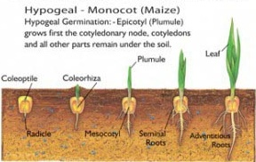
Hypogeal germination
In hypogeal germination, the epicotyls elongate thrusting the plumule upwards out of the ground leaving the cotyledons below the ground. Eg. Maize, Rice, Millet, Garden pea, etc.

Slide 10
MITOSIS
Cell are the building block of life
Cell division cycle is basically a series of events which occurs during cell division and replication
In prokaryotic cells, i.e. cells without nucleus, the cell cycle occurs through a process called binary fission
In eukaryotic cells, i.e. cells with nucleus, the cell cycle can be divided into four distinct phases: G1 phase (cell growth period), S phase (DNA synthesis or replication occurs), G2 phase (cell undergoes a period of rapid growth to prepare for mitosis) and M phase (mitosis).

Slide 11
G1 phase, S phase and G2 phase are collectively known as interphase, wherein the cell grows, collects nutrients for mitosis and duplicates its DNA
M phase (mitosis and cytokinesis), is the process in which the cell divides itself into two distinct cells, termed as daughter cells

Slide 12
Before cell division occurs, the cell first has to replicate the chromosomes so each daughter cell can have a set. When the chromosomes are replicated and getting ready to divide, they consist of two, identical halves called sister chromatids which are joined by a central region, the centromere. Each chromosome is one long molecule of DNA and special proteins. DNA makes up the genes, and we say that genes are “on” chromosomes, or chromosomes “contain” or are made of genes.

Slide 13
Prophase: In this stage, the chromatin begins to shorten and condense due to coiling, to form chromosomes. Centrioles start moving to the opposite ends of the cell and the spindle fibers extend from the centromeres (condensed region of each chromosome). The nuclear membrane and nucleolus can no longer be seen now. Prometaphase: In prometaphase, each chromosome forms two kinetochores (protein structure on chromosomes) at the centromere, one attached at each chromatid. Microtubules (structural components of the cell) attach at the kinetochores and the chromosomes start moving. Metaphase: The spindle fibers attach themselves to the centromere of the chromosomes and align them along the middle of the cell nucleus. The line is referred as the equatorial plate or metaphase plate. This alignment will ensure that in the next phase, when the chromosomes will separate, each newly formed nucleus will get one copy of each chromosome.

Slide 14
Anaphase: In this phase, as the spindle fiber shorten and the centromere splits, the paired chromosomes will separate and start moving to the opposite sides of the cell. Though the reason for this motion is still unknown, according to some studies, it is the rapid assembly and breakdown of microtubules that may cause this movement. Hence, at the end of anaphase, we get two separate identical copies of sister chromosomes. Telophase: In telophase, the sister chromosomes attach at the opposite ends of the pole and a new nuclear membrane is formed around each set of sister chromosomes. The spindle fibers also disintegrate. Cytokinesis: Though not a phase of mitosis, cytokinesis is a separate process that completes the entire process of cell division. It is a process of splitting the daughter cells apart by forming a furrow wherein the cell is pinched in to two. By the end of this process, each daughter cell has a complete copy of the genome of its parent cell, i.e. same number and quality of chromosomes.

Slide 15
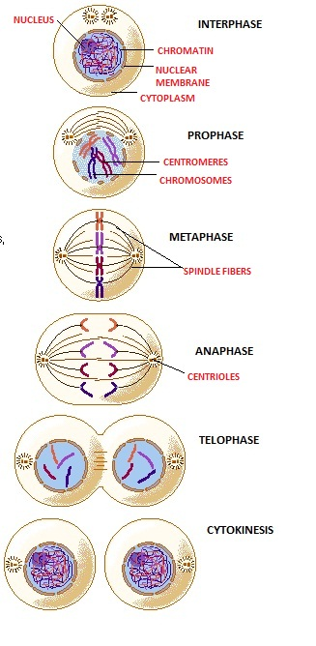

Slide 16
Conditions required for seed germination
Availability of water
Availability of oxygen
Suitable temperature
Sometimes light

Slide 17
Water –
A seed contains 10-15% of water and is generally dehydrated. So the viable non-dormant seed has to absorb water through micropyle or through permeable seed coat to become active and exhibit germination.
Water hydrates the seed making the seed coat to soften, swell and weaken and also hydrates the embryo.
Enzymes that are present in the seeds are activated because of the hydration.
It is also used for the cell enlargement and cell division which results in the elongation of the radicle.
As the radicle elongates it pushes its way through the testa which has been soften and weakened and emerges out of the seed.
When the radicle emerges out the germination is completed.

Slide 18
Oxygen –
In the dormant condition the seeds respiratory rate is very low due to low metabolic rate and so oxygen is required in very small quantities.
For germination, oxygen is needed in large quantities. The seeds obtain this oxygen from the air contained in the soil.
Oxygen is required for the aerobic respiration which provides the growing embryo with maximum energy for cell division and cell enlargement.
In the absence of oxygen, the embryo undergoes anaerobic respiration that results in the formation of ethanol or acetic acid which are poisonous to the embryo and hinders its further growth.

Slide 19
Temperature –
a suitable temperature is required for germination because of enzymes that catalyze the metabolic activities. Enzymes haves minimum, optimum and maximum temperature requirements.
The range of temperature requirement is higher for tropical plants then for temperate. This is reflected in the temperature requirement of seeds and the best germination occurs at the optimum temperature range.
Enzymes are sensitive to heat and are denatured (completely destroyed) at higher temperature above 60⁰C. Below 0⁰C enzymes are normally inactivated but not destroyed.
Examples of cardinal temperatures (⁰C) for germination of Grains/seeds
Grain/Seed | Minimum | Optimum | Maximum
Zea mays (Maize) | 8-10 | 32-35 | 40-44
Cucumis melo (Melon) | 16-19 | 30-34 | 45-50
Oryza sativa(Rice) | 10-12 | 30-37 | 40-42

Slide 20
Light –
Not all the seeds are affected by light. However, the seeds of certain grasses and some varieties of lettuce require light for germination.
These seeds will not germinate in absence of light because of an inhibitor which is only broken down by in presence of light.
Most of the small sized seeds require light for germination and their germination is inhibited when buried deep in the soil.
In contrast, the seeds of other plants such as onion, geraniums and poppies will germinate only in the dark. In these light stimulates the synthesis of compounds that inhibit seed germination.

